Slide 1


Innovation Pods™
August 23, 2016

Slide 2




Objective of this document
To share UST Global point of view on how we help our customers
Get to meaningful problem definitions quickly
Explore solution pathways and prioritize the
right solution
Co-author a commercial glide path to quickly scale & optimize the solution

Slide 3

We believe innovation cannot be centralized, nor can be outsourced…
Our approach - Federated Innovation Pods

Slide 4



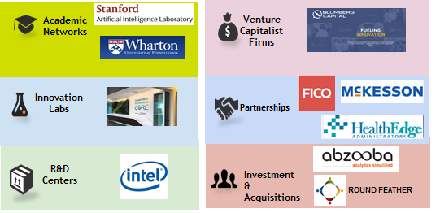



Federated Innovation Pods™
A federated model helps you focus on specific areas leveraging
ABS’s innovation model augmented by our
Innovation &
D4H Methodologies
ID³ Framework
Ecosystem
The 3 main vectors of our innovation pod are:
Our incredible agility to define problems and generate high fidelity consumer/ employee insights
Turbo speed translation of insights into commercially viable MVCs & MVPs
Access to industry leading ecosystem of experts & resources/tools to quickly & effectively co-create solutions

Slide 5


What is an Innovation Pod™?
A team of 3 – Domain lead, Innovation lead, Technology lead working with you to sense and create meaningful problem definitions
Fine tuned innovation processes through
Agile Innovation
Brings Minimum Viable Concepts(MVC) to you in
3 to 4 weeks
UST Ecosystem to create disruptive and cutting edge innovative solutions
Curates MVCs into Minimum Viable Products(MVP) in
12 to16 weeks
An Innovation Management Solution that complements and accelerates your innovation capabilities

Slide 6
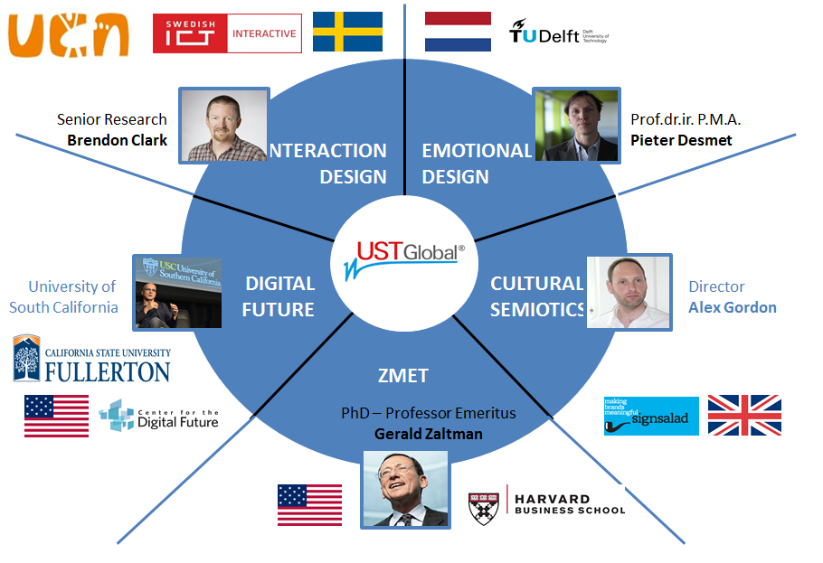
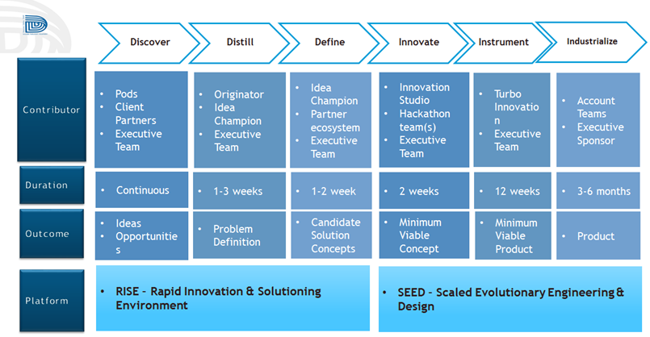
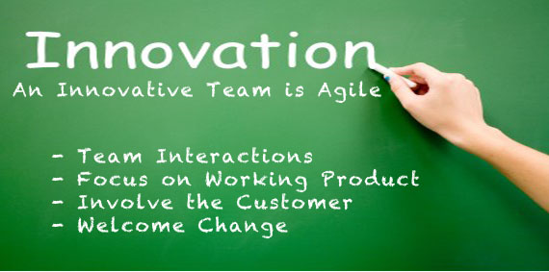
What are our Differentiators?
Design For Happiness (D4H)
The Ecosystem
Our proprietary methodology to get deep consumer insights and understand the ‘why’ behind the problems
Our investments in
Academic networks, VCs, Research Labs
Design Sprints, Open and Closed Hackathons
Scale @ Turbo Speed
Hyper Agile
UST ID³ framework
to co-create ideal solutions at speed
Agile Innovation frameworks to accelerate success and ignite creativity

Slide 7



UST ID³ Framework
Discover
Distill
Define
Innovate
Instrument
Industrialize
Pods,
Client Partners, Executive Teams
Originator,
Idea Champion, Executive Teams
Idea Champion, Partner Ecosystem,
Executive Teams
Innovation Studio, Hackathon,
Executive Teams
Turbo Innovation, Executive Teams
Account Team, Executive Sponsor
Contributor
Duration
Continuous
1-3 Weeks
1-2 Weeks
2 Weeks
12 Weeks
3-6 Months
Ideas, Opportunities
Problem Definition
Candidate Selection Concepts
Minimum Viable Concept (MVC)
Minimum Viable Product (MVP)
Product
Outcome
Platform
RISE- Rapid Innovation & Solution Environment
SEED- Scaled Evolutionary Engineering & Design

Slide 8
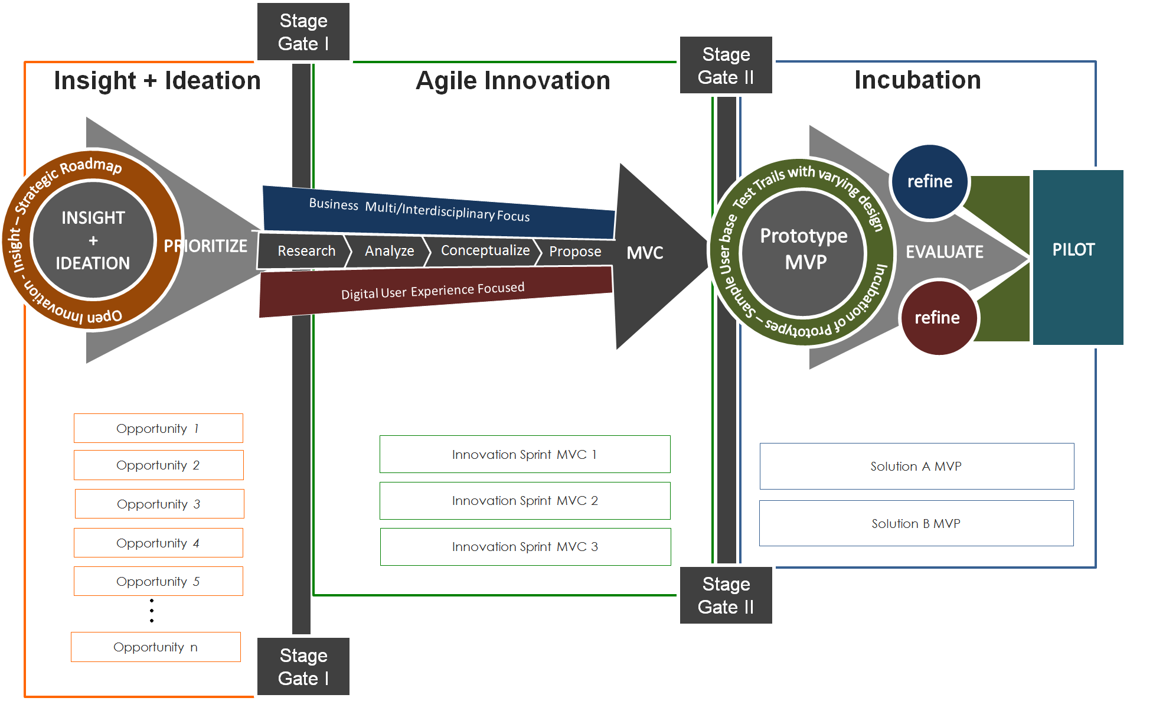
The Method: Problems → MVCs → MVPs at Turbo Speed and Scale
Minimum Viable Concept (MVC)
A concept derived from an idea leveraging the insights
A clickable prototype
Minimum Viable Product (MVP)
A pilot/solution that implements the MVC
Pilots the critical parts of the solution
Cannot be industrialized

Slide 9
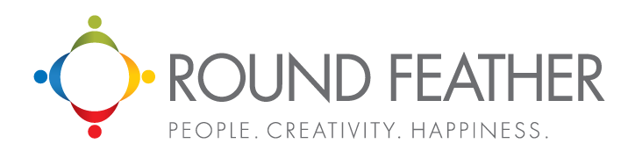
Why UST Innovation Pods™?
Business Acumen &
IT Knowledge
Our deep domain and personalized understanding of
your business and IT systems
Design For Happiness (D4H)
Our proprietary methodology to get deep consumer insights
proven with fortune 100 companies
We help you arrive at meaningful problem definitions
aligned across all key stakeholders
We help you co-create & help orchestrate a suite of solution choices
We work with you to identify the ideal solution for the problems that can quickly scale and is commercially viable
UST ID³
Framework
Complement your Innovation
An Innovation Management Solution that complements and accelerates your innovation capabilities
Retail Expertize
Our deep understanding of retail domain working with
8 of the top retailers of the world

